Slide 1
Intelligent System
Uninformed Search
Nunung Nurul Qomariyah
nunung.qomariyah@binus.edu

Slide 2
Session Learning Outcomes
Upon completion of this session, students are expected to be able to
LO 2 Understand different approaches and techniques in AI.
LO 3 Understand basic mathematical background used in AI.
LO 4 Apply appropriate computing and mathematical techniques in AI case.

Slide 3
Outline
Problem-solving agents
State space representations
Searching in the state space
Uninformed Search algorithms

Slide 4
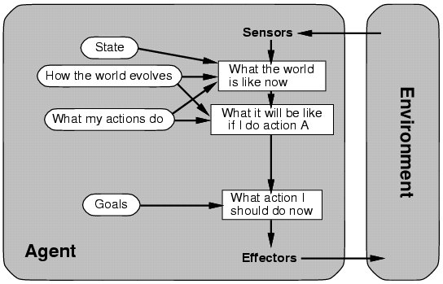
Problem-Solving (Goal-Based) Agent

Slide 5
Building a Problem-Solving Agent
What goal / problem does the agent try to achieve / solve?
What knowledge does the agent need?
What actions does the agent need to do?

Slide 6
Goal Formulation
What goal does the agent need to achieve?
How do you describe the goal?
as a problem to be accomplished
as a situation to be reached
as a set of properties to be acquired.
How do you know when the goal is reached?
goal test
defines what it means to have achieved/satisfied the goal.

Slide 7
Knowledge Formulation
What knowledge does the agent need?
The information needs to be
sufficient to describe all relevant aspects to reaching the goal
adequate to describe the world state/situation
For now, we'll assume:
All necessary information about a problem domain is observable: each state is a complete description of the world.

Slide 8
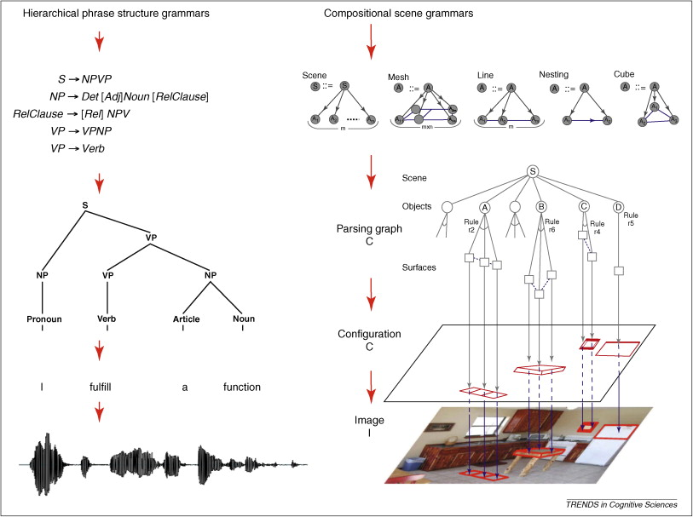
Knowledge Representation
How should the agent's knowledge be represented?
Appropriate Level of Abstraction:
Removing detail from a representation while retaining relevant information for solving the problem.

Slide 9
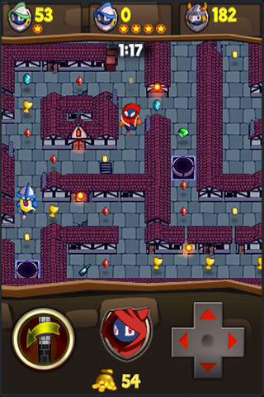
Actions Formulation
What actions does the agent need to do?
decomposed into primitive steps that are discrete
sufficient to describe all necessary changes.
The number of actions needed depends on how the world states are represented.

Slide 10
Actions Formulation (2)
What actions does the agent need to do?
Given:
possible actions (operators / moves)
a description of the current state of the world
Choose the best action that leads to solution by searching:
what are the possible actions that can be performed in that particular state?
what the exact state of the world will be after the action is performed?

Slide 11

Example: Vacuum-Cleaner
States: 8 states
Initial state: any state
Actions: Left, Right, and Suck
Transition model: The actions have their expected effects
Goal test: whether both squares are clean
Path cost: each step costs 1
transition model – description of what each action does.

Slide 12
Example: Vacuum-Cleaner

Slide 13
Example: 8-puzzle

Slide 14
Example: 8-puzzle
States: location of each tile and the blank
Initial state: any
Actions: blank moves Left, Right, Up or Down
Transition model: Given a state and action, returns the resulting state
Goal test: whether it matches the goal state
Path cost: Each step costs 1
transition model – description of what each action does.

Slide 15
Formalizing Search in a State Space
A State Space is a graph: (V, E)
V is a set of nodes / vertices (states)
E is a set of edges (actions), each edge is directed from one node to another node
Each node is a data structure that contains:
state: the state description
parent node: the node that generated this node
action: the action that was applied to the parent to generate this node
path cost: the cost of the path from the start state to this state
depth: number of steps in the path from the start state

Slide 16
State-Space Example
S
start
The size of a problem is usually described in terms of the number of nodes in the game tree:
5
2
4
A
B
C
9
4
6
2
6
1
Tic-Tac-Toe: 9! nodes
Rubik's Cube: 10¹⁹ nodes
Reversi/Othello: 10⁵⁸ nodes
Chess: 10¹²³ nodes
Go: 10³⁶⁰ nodes
D
E
G
goal
F
7
H

Slide 17
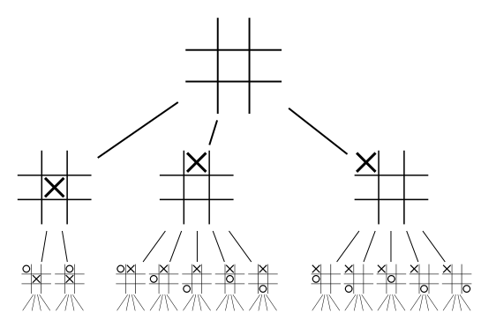
State-Space Example
Partial game tree of a Tic-Tac-Toe game:

Slide 18
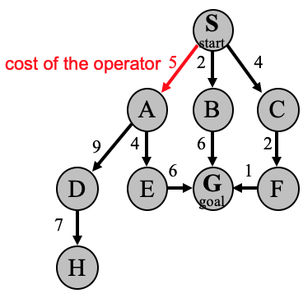
State Space Formalism
Each edge corresponds to one of the operators
Each edge has a fixed, positive cost:
corresponds to the cost of the operator
(also called the edge / step cost)

Slide 19
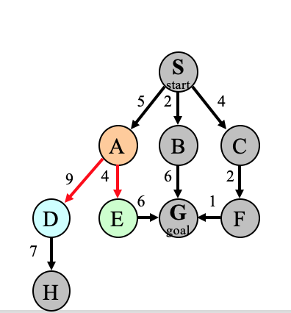
State Space Formalism (2)
Each node has a set of successor nodes:
Expanding a node means:
generate all of the successor nodes
add them and their associated edges to the state-space graph

Slide 20
State Space Formalism (3)
One or more nodes are designated as start nodes
A goal test is applied to a node's state to determine if it is a goal node
A solution is a sequence of operators associated with a path in a state space from a start node to a goal node
The cost of a solution is the sum of the edge / step costs on the solution path

Slide 21
State Space Search
State-space search is the process of searching for a solution
initially V = { S }, where S is the start node
each node in V is then checked whether it is a goal node, if not then the node is expanded:
its successors are generated and added to V and their associated edges are added to E
this process continues until a goal node is found

Slide 22
State Space Search (2)
Each node represents:
a partial solution path from the
start node to the given node
cost of the partial solution path.
From this node there are:
many possible paths that have
this partial path as a prefix
many possible solutions.
S
start
5
2
4
A
B
C
9
4
6
2
6
1
D
E
G
goal
F
7
H

Slide 23
State-Space Search Implementation
Node generalSearch (Problem problem, List nodes)
Problem: object that contains
start state, getStartState()
operators/moves
operator costs
goal test, isGoal( ): tests if given node's state satisfies all goal conditions
List: some data structure
holds a ranked list of nodes that is initially empty
add() & remove(): adds & removes a node from the list of unexpanded nodes
Node: either a goal, non-goal, or “failure” node.

Slide 24
State-Space Search Implementation (2)
// Note: this algorithm doesn't detect loops in the state space
// See last slide for loop detecting algorithm
Node generalSearch (Problem problem, List nodes)
{
nodes.add( new Node( problem.getStartState() ) ); // add to node list
while (true) {
if ( nodes.isEmpty( ) )
return new Node("failure");
Node node = nodes.remove( ); // removes front node
if ( problem.isGoal( node.getState( ) ) )
return node;
// expand: generates all of this node's children nodes
nodes.add( expand node given problem operators );
}
}

Slide 25
Algorithm’s Key Issues
Search process constructs a search tree
root is the start state
leaf nodes are:
unexpanded nodes (in the nodes list)
dead ends
(nodes that aren't goals and have no successors because no operators were applicable)
goal node is last leaf node found
Loops in the graph may cause the search tree to be infinite even if state space is small.

Slide 26
Algorithm’s Key Issues (2)
Changing definition of how nodes are added to nodes list leads to different search strategies.
Solution desired may be:
just the goal state
a path from start to goal state.
S
start
5
2
4
A
B
C
9
4
6
2
D
E
6
G
goal
1
F
7
H

Slide 27
Evaluating Search Strategies
Completeness
If a solution exists, will it be found?
a complete algorithm will find a solution.
Optimality / Admissibility
If a solution is found, is it guaranteed to be optimal?
an admissible algorithm will find a solution with minimum cost.

Slide 28
Evaluating Search Strategies (2)
Time Complexity
How long does it take to find a solution?
measured for worst or average case
measured in number of nodes expanded/tested.
Space Complexity
How much memory is used by the algorithm?
measured in terms of the maximum size of the nodes list during the search.

Slide 29
Uninformed Search Strategies
Uninformed Search (blind search)
They do not know whether a node is “more promising” than the others.
BFS: breadth-first search
queue (FIFO) used to order nodes, add to rear
DFS: depth-first search
stack (LIFO) used to order nodes, add to front
Depth-limited search:
DFS with limited depth

Slide 30
Uninformed Search Strategies (2)
UCS: uniform-cost search
priority queue used to order nodes, sorted by path cost
let g(n) = cost of path from start node s to current node n
sort nodes by increasing value of g
UCS is the only uninformed search that uses cost information

Slide 31
Uninformed Search Strategies (3)
IDS: iterative-deepening (depth-first) search
requires modification to the tree search algorithm:
do DFS to depth 1
treat all children of the start node as leafs
if no solution found, do DFS to depth 2
repeat by increasing depth until a solution found
Combines the (benefits of) depth-first and breadth-first search.

Slide 32
Breadth-First Search Example
generalSearch( problem, queue )
# of nodes tested: 0, expanded: 0
S
start
expnd. node
node list
5
2
4
{S}
A
B
C
9
4
6
2
6
1
D
E
G
goal
F
7
H

Slide 33
BFS Example (2)
generalSearch( problem, queue)
# of nodes tested: 1, expanded: 1
S
start
expnd. node
node list
5
2
4
{S}
A
B
C
S not goal
{A,B,C}
9
4
6
2
6
1
D
E
G
goal
F
7
H

Slide 34
BFS Example (3)
generalSearch( problem, queue)
# of nodes tested: 2, expanded: 2
S
start
expnd. node
node list
5
2
4
{S}
A
B
C
S not goal
{A,B,C}
A not goal
{B,C,D,E}
9
4
6
2
6
1
D
E
G
goal
F
7
H

Slide 35
BFS Example (4)
generalSearch( problem, queue)
# of nodes tested: 3, expanded: 3
S
start
expnd. node
node list
5
2
4
{S}
A
B
C
S not goal
{A,B,C}
A not goal
{B,C,D,E}
9
4
6
2
B not goal
{C,D,E,G}
6
1
D
E
G
goal
F
7
H

Slide 36
BFS Example (5)
generalSearch( problem, queue)
# of nodes tested: 4, expanded: 4
S
start
expnd. node
node list
5
2
4
{S}
A
B
C
S not goal
{A,B,C}
A not goal
{B,C,D,E}
9
4
6
2
B not goal
{C,D,E,G}
6
1
D
E
G
goal
F
C not goal
{D,E,G,F}
7
H

Slide 37
BFS Example (6)
generalSearch( problem, queue)
# of nodes tested: 5, expanded: 5
S
start
expnd. node
node list
5
2
4
{S}
A
B
C
S not goal
{A,B,C}
A not goal
{B,C,D,E}
9
4
6
2
B not goal
{C,D,E,G}
6
1
D
E
G
goal
F
C not goal
{D,E,G,F}
D not goal
{E,G,F,H}
7
H

Slide 38
BFS Example (7)
generalSearch( problem, queue)
# of nodes tested: 6, expanded: 6
S
start
expnd. node
node list
5
2
4
{S}
A
B
C
S not goal
{A,B,C}
A not goal
{B,C,D,E}
9
4
6
2
B not goal
{C,D,E,G}
6
1
D
E
G
goal
F
C not goal
{D,E,G,F}
D not goal
{E,G,F,H}
7
E not goal
{G,F,H,G}
H

Slide 39
BFS Example (8)
generalSearch( problem, queue)
# of nodes tested: 7, expanded: 6
S
start
expnd. node
node list
5
2
4
{S}
A
B
C
S not goal
{A,B,C}
A not goal
{B,C,D,E}
9
4
6
2
B not goal
{C,D,E,G}
6
1
D
E
G
goal
F
C not goal
{D,E,G,F}
D not goal
{E,G,F,H}
7
E not goal
{G,F,H,G}
H
G is goal
{F,H,G}
Path: S, B, G
Cost: 8

Slide 40
BFS Properties
Complete
if the branching factor is finite
Optimal
Yes, if the path cost is a non-decreasing function of depth of the node, e.g. when all edges have the same cost
otherwise, not optimal but does guarantee finding solution of shortest length (i.e. fewest edges)
Time and space complexity? Linear?

Slide 41
BFS Properties (2)
Time and space complexity:
O( |V||E| ) = O( b^{d+1} ) ≈ exponential
d is the depth of the solution
b is the branching factor at each non-leaf node
Will take a long time and need a huge memory to find solutions with a large number of steps
because must look at all shorter length possibilities first.

Slide 42
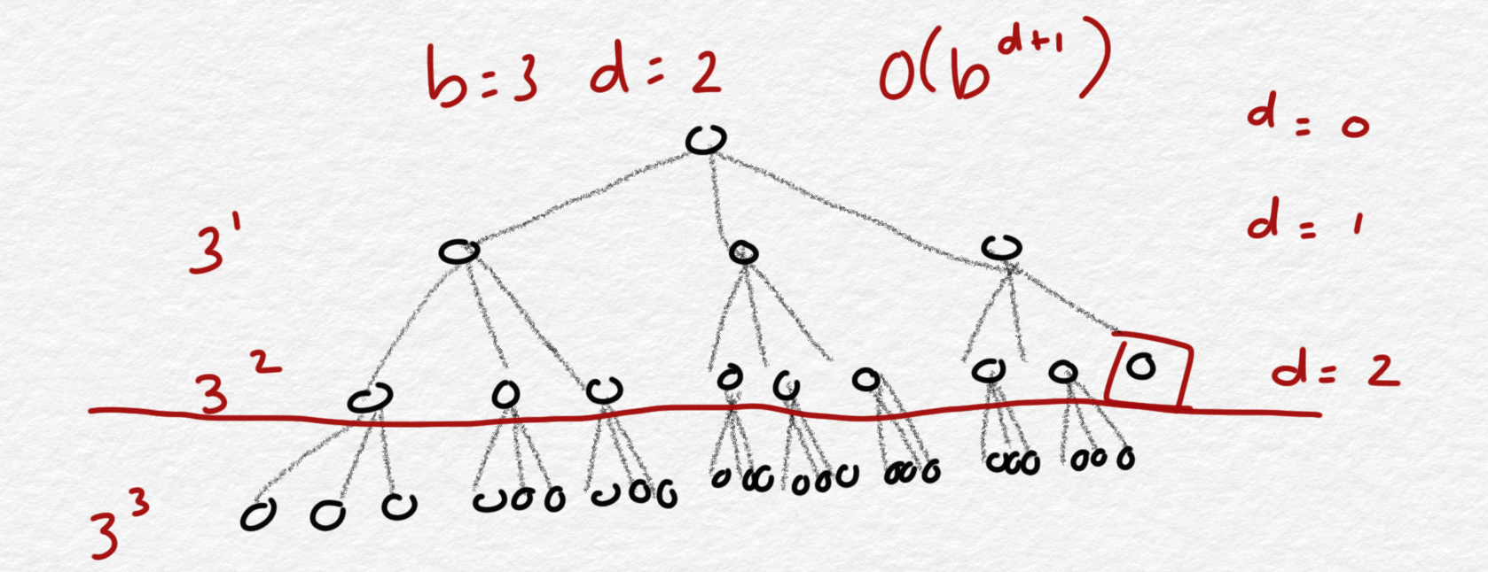
BFS Properties (3)
In the worst case, the total number of nodes in the search tree is:
b + b² + ... + b^{d} + (b^{(d+1)} - b) = O(b^{d+1})
d : the solution tree's depth
b : the branching factor at each non-leaf node
In the worst case, the Goal will be at the far, right corner leaf of the search tree, so the algorithm will have to search all the nodes in the tree, plus one extra level of b nodes to account for our stopping condition i.e., b^{d} x b¹= O(b^{d+1}).
Notes:
We can’t discard anything as the nodes will not visited if the traversal is not yet reaching the end of the node in the specific depth level. We need to expand all the nodes at the depth+1, when examining the goal at the current depth.

Slide 43
BFS Properties (4)
For example: d = 12 , b = 10
10 + 100 + ... + 10¹² + (10¹³ - 10) = O(10¹³ )
If BFS expands 10000 nodes/sec and each node uses 1000 bytes of storage, then BFS will take 35 years to run, and it will use 10 petabytes of memory!

Slide 44
Depth-First Search Example
generalSearch( problem, stack )
# of nodes tested: 0, expanded: 0
S
start
expnd. node
node list
5
2
4
{S}
A
B
C
9
4
6
2
6
1
D
E
G
goal
F
7
H

Slide 45
DFS Example (2)
generalSearch( problem, stack)
# of nodes tested: 1, expanded: 1
S
start
expnd. node
node list
5
2
4
{S}
A
B
C
S not goal
{A,B,C}
9
4
6
2
6
1
D
E
G
goal
F
7
H

Slide 46
DFS Example (3)
generalSearch( problem, stack)
# of nodes tested: 2, expanded: 2
S
start
expnd. node
node list
5
2
4
{S}
A
B
C
S not goal
{A,B,C}
A not goal
{D,E,B,C}
9
4
6
2
6
1
D
E
G
goal
F
7
H

Slide 47
DFS Example (4)
generalSearch( problem, stack)
# of nodes tested: 3, expanded: 3
S
start
expnd. node
node list
5
2
4
{S}
A
B
C
S not goal
{A,B,C}
A not goal
{D,E,B,C}
9
4
6
2
D not goal
{H,E,B,C}
6
1
D
E
G
goal
F
7
H

Slide 48
DFS Example (5)
generalSearch( problem, stack)
# of nodes tested: 4, expanded: 3
S
start
expnd. node
node list
5
2
4
{S}
A
B
C
S not goal
{A,B,C}
A not goal
{D,E,B,C}
9
4
6
2
D not goal
{H,E,B,C}
6
1
D
E
G
goal
F
H not goal
{E,B,C}
7
H

Slide 49
DFS Example (6)
generalSearch( problem, stack)
# of nodes tested: 5, expanded: 4
S
start
expnd. node
node list
5
2
4
{S}
A
B
C
S not goal
{A,B,C}
A not goal
{D,E,B,C}
9
4
6
2
D not goal
{H,E,B,C}
6
1
D
E
G
goal
F
H not goal
{E,B,C}
E not goal
{G,B,C}
7
H

Slide 50
DFS Example (7)
generalSearch( problem, stack)
# of nodes tested: 6, expanded: 4
S
start
expnd. node
node list
5
2
4
{S}
A
B
C
S not goal
{A,B,C}
A not goal
{D,E,B,C}
9
4
6
2
D not goal
{H,E,B,C}
6
1
D
E
G
goal
F
H not goal
{E,B,C}
E not goal
{G,B,C}
7
G is goal
{B,C}
H
Path: S, A, E, G
Cost: 15

Slide 51
DFS Properties
May not terminate without a loop detection or depth bound (that cuts off search below a fixed depth)
Not complete
without cycle detection
Not optimal
Can find long solutions quickly if lucky.

Slide 52
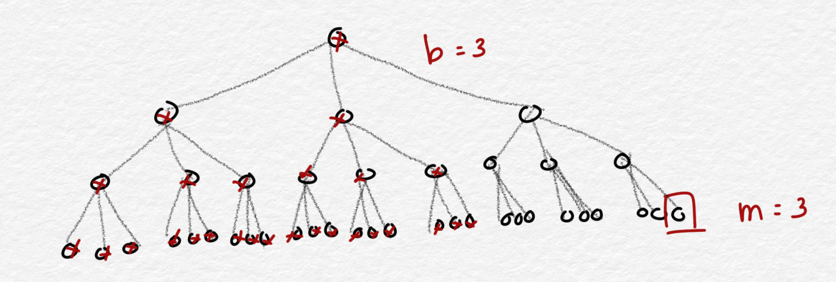
DFS Properties (2)
Time complexity: O( b^{m} ) ≈ exponential
Space complexity: O( bm ) ≈ linear (less than BFS)
m : the maximum depth of the search tree
b : the branching factor at each non-leaf node
Only store the nodes at the last subtree
chronological backtracking
when search hits a dead end, backs up one level at a time
Notes:
Space complexity is smaller than BFS because DFS can remove the nodes after all descendants have been visited

Slide 53
Uniform-Cost Search Example
generalSearch( problem, priorityQueue )
# of nodes tested: 0, expanded: 0
S
start
expnd. node
node list
5
2
4
{S}
A
B
C
9
4
6
2
6
1
D
E
G
goal
F
7
H

Slide 54
UCS Example (2)
generalSearch( problem, priorityQueue )
# of nodes tested: 1, expanded: 1
S
start
expnd. node
node list
5
2
4
{S:0}
A
B
C
S not goal
{B:2,C:4,A:5}
9
4
6
2
6
1
D
E
G
goal
F
7
H

Slide 55
UCS Example (3)
generalSearch( problem, priorityQueue )
# of nodes tested: 2, expanded: 2
S
start
expnd. node
node list
5
2
4
{S:0}
A
B
C
S not goal
{B:2,C:4,A:5}
B not goal
{C:4,A:5,G:2+6}
9
4
6
2
6
1
D
E
G
goal
F
7
H

Slide 56
UCS Example (4)
generalSearch( problem, priorityQueue )
# of nodes tested: 3, expanded: 3
S
start
expnd. node
node list
5
2
4
{S:0}
A
B
C
S not goal
{B:2,C:4,A:5}
B not goal
{C:4,A:5,G:8}
9
4
6
2
C not goal
{A:5,F:4+2,G:8}
6
1
D
E
G
goal
F
7
H

Slide 57
UCS Example (5)
generalSearch( problem, priorityQueue )
# of nodes tested: 4, expanded: 4
S
start
5
2
4
expnd. node
node list
{S:0}
A
B
C
S not goal
{B:2,C:4,A:5}
9
4
6
2
B not goal
{C:4,A:5,G:8}
6
1
C not goal
{A:5,F:6,G:8}
D
E
G
goal
F
A not goal
{F:6,G:8,E:5+4,D:5+9}
7
H

Slide 58
UCS Example (6)
generalSearch( problem, priorityQueue )
# of nodes tested: 5, expanded: 5
S
start
expnd. node
node list
5
2
4
{S:0}
A
B
C
S not goal
{B:2,C:4,A:5}
B not goal
{C:4,A:5,G:8}
9
4
6
2
C not goal
{A:5,F:6,G:8}
6
1
D
E
G
goal
F
A not goal
{F:6,G:8,E:9,D:14}
F not goal
{G:6+1,G:8,E:9,D:14}
7
H

Slide 59
UCS Example (7)
generalSearch( problem, priorityQueue )
# of nodes tested: 6, expanded: 5
S
start
expnd. node
node list
5
2
4
{S:0}
A
B
C
S not goal
{B:2,C:4,A:5}
B not goal
{C:4,A:5,G:8}
9
4
6
2
C not goal
{A:5,F:6,G:8}
6
1
D
E
G
goal
F
A not goal
{F:6,G:8,E:9,D:14}
F not goal
{G:7,G:8,E:9,D:14}
7
G is goal
{G:8,E:9,D:14}
H
Path: S, C, F, G
Cost: 7

Slide 60
UCS Properties
One well known variant is called Dijkstra's Algorithm in the literature.
which is a UCS without a goal state, to find the shortest paths to all nodes
Complete and Optimal
If brancing factor is finite
If step costs >= e (for positive e)
e is the minimum edge cost

Slide 61
UCS Properties (2)
The complexity:
is exponential in the optimal solution cost (C*) divided by the minimum cost of an action (edge): O( b^{1+ ⎣C*/e⎦} )
which is = O( b^{d+1} ) when all edge costs are equal.
Time and space complexity: O( b^{d} ) ≈ exponential
d : the depth of the shallowest solution
b : the branching factor at each non-leaf node
Notes:
Because UCS search based on the cost not the depth, then the function will be depend on the cost function.
When all step cost are the same, UCS is similar to BFS, except that BFS stops as soon as it reach the Goal state, But UCS keep searching for the optimal solution. UCS does more work than BFS.

Slide 62
Depth Limited Search
General Principle:
The nodes expansion is limited to a predetermined depth limit (l).
Depth-first Search can be viewed as a special case of DLS, when l = ∞.
Termination with failure:
No solution at all.
No solution within the depth limit.

Slide 63
DLS Example
depthLimitedSearch( problem, stack, limit )
depth: 0, limit: 1, # of nodes tested: 0, expanded: 0
S
start
expnd. node
node list
5
2
4
{S}
A
B
C
9
4
6
2
6
1
D
E
G
goal
F
7
H

Slide 64
DLS Example (2)
depthLimitedSearch( problem, stack, limit )
depth: 1, limit: 1, # of nodes tested: 1, expanded: 1
S
start
expnd. node
node list
5
2
4
{S}
A
B
C
S not goal
{A,B,C}
9
4
6
2
6
1
D
E
G
goal
F
7
H

Slide 65
DLS Example (3)
depthLimitedSearch( problem, stack, limit )
depth: 1, limit: 1, # of nodes tested: 2, expanded: 1
S
start
expnd. node
node list
5
2
4
{S}
A
B
C
S not goal
{A,B,C}
A not goal
{B,C} no expand
9
4
6
2
6
1
D
E
G
goal
F
7
H

Slide 66
DLS Example (4)
depthLimitedSearch( problem, stack, limit )
depth: 1, limit: 1, # of nodes tested: 3, expanded: 1
S
start
expnd. node
node list
5
2
4
{S}
A
B
C
S not goal
{A,B,C}
A not goal
{B,C} no expand
9
4
6
2
B not goal
{C} no expand
6
1
D
E
G
goal
F
7
H

Slide 67
DLS Example (5)
depthLimitedSearch( problem, stack, limit )
depth: 1, limit: 1, # of nodes tested: 4, expanded: 1
S
start
expnd. node
node list
5
2
4
{S}
A
B
C
S not goal
{A,B,C}
A not goal
{B,C} no expand
9
4
6
2
B not goal
{C} no expand
6
1
D
E
G
goal
F
C not goal
{} no expand
7
H
Failure

Slide 68
DLS Evaluation
Completeness and Optimality:
Not complete if l < d.
Not optimal if l > d.
Time Complexity:
O(b^{l})
Space Complexity:
O(bl)

Slide 69
IDS Example
deepeningSearch( problem, stack )
depth: 1, # of nodes tested: 0, expanded: 0
S
start
expnd. node
node list
5
2
4
{S}
A
B
C
9
4
6
2
6
1
D
E
G
goal
F
7
H

Slide 70
IDS Example (2)
deepeningSearch( problem, stack )
depth: 1, # of nodes tested: 1, expanded: 1
S
start
expnd. node
node list
5
2
4
{S}
A
B
C
S not goal
{A,B,C}
9
4
6
2
6
1
D
E
G
goal
F
7
H

Slide 71
IDS Example (3)
deepeningSearch( problem, stack )
depth: 1, # of nodes tested: 2, expanded: 1
S
start
expnd. node
node list
5
2
4
{S}
A
B
C
S not goal
{A,B,C}
A not goal
{B,C} no expand
9
4
6
2
6
1
D
E
G
goal
F
7
H

Slide 72
IDS Example (4)
deepeningSearch( problem, stack )
depth: 1, # of nodes tested: 3, expanded: 1
S
start
expnd. node
node list
5
2
4
{S}
A
B
C
S not goal
{A,B,C}
A not goal
{B,C} no expand
9
4
6
2
B not goal
{C} no expand
6
1
D
E
G
goal
F
7
H

Slide 73
IDS Example (5)
deepeningSearch( problem, stack )
depth: 1, # of nodes tested: 4, expanded: 1
S
start
expnd. node
node list
5
2
4
{S}
A
B
C
S not goal
{A,B,C}
A not goal
{B,C} no expand
9
4
6
2
B not goal
{C} no expand
6
1
D
E
G
goal
F
C not goal
{} no expand
7
H

Slide 74
IDS Example (6)
deepeningSearch( problem, stack )
depth: 2, # of nodes tested: 4(1), expanded: 2
S
start
5
2
4
expnd. node
node list
{S}
A
B
C
S not goal
{A,B,C}
9
4
6
2
A not goal
{B,C} no expand
6
1
B not goal
{C} no expand
D
E
G
goal
F
C not goal
{} no expand
7
S no test
{A,B,C}
H

Slide 75
IDS Example (7)
deepeningSearch( problem, stack )
depth: 2, # of nodes tested: 4(2), expanded: 3
S
start
5
2
4
expnd. node
node list
{S}
A
B
C
S not goal
{A,B,C}
9
4
6
2
A not goal
{B,C} no expand
6
1
B not goal
{C} no expand
D
E
G
goal
F
C not goal
{} no expand
7
S no test
{A,B,C}
A no test
{D,E,B,C}
H

Slide 76
IDS Example (8)
deepeningSearch( problem, stack )
depth: 2, # of nodes tested: 5(2), expanded: 3
S
start
5
2
4
expnd. node
node list
{S}
A
B
C
S not goal
{A,B,C}
9
4
6
2
A not goal
{B,C} no expand
6
1
B not goal
{C} no expand
D
E
G
goal
F
C not goal
{} no expand
7
S no test
{A,B,C}
A no test
{D,E,B,C}
H
D not goal
{E,B,C} no expand

Slide 77
IDS Example (9)
deepeningSearch( problem, stack )
depth: 2, # of nodes tested: 6(2), expanded: 3
S
start
5
2
4
expnd. node
node list
{S}
A
B
C
S not goal
{A,B,C}
9
4
6
2
A not goal
{B,C} no expand
6
1
B not goal
{C} no expand
D
E
G
goal
F
C not goal
{} no expand
7
S no test
{A,B,C}
A no test
{D,E,B,C}
H
D not goal
{E,B,C} no expand
E not goal
{B,C} no expand

Slide 78
IDS Example (10)
deepeningSearch( problem, stack )
depth: 2, # of nodes tested: 6(3), expanded: 4
S
start
expnd. node
node list
5
2
4
{S}
A
B
C
S not goal
{A,B,C}
A not goal
{B,C} no expand
9
4
6
2
B not goal
{C} no expand
6
1
D
E
G
goal
F
C not goal
{} no expand
S no test
{A,B,C}
7
A no test
{D,E,B,C}
H
D not goal
{E,B,C} no expand
E not goal
{B,C} no expand
B no test
{G,C}

Slide 79
IDS Example (11)
deepeningSearch( problem, stack )
depth: 2, # of nodes tested: 7(3), expanded: 4
S
start
expnd. node
node list
{S}
5
2
4
S not goal
{A,B,C}
A
B
C
A not goal
{B,C} no expand
B not goal
{C} no expand
9
4
6
2
C not goal
{} no expand
6
1
D
E
G
goal
F
S no test
{A,B,C}
A no test
{D,E,B,C}
7
D not goal
{E,B,C} no expand
H
Path: S, B, G
Cost: 8
E not goal
{B,C} no expand
B no test
{G,C}
G is goal
{C} no expand

Slide 80
IDS Properties
Has the advantages of BFS
Complete
Optimal (if the edges have identical costs)
Has the advantages of DFS
Linear space complexity: O( bd )
Finds longer paths more quickly
Wasteful ?
because nodes near the top of the search tree are generated multiple times

Slide 81
IDS Properties (2)
It turns out this is NOT very costly
For a tree with (nearly) the same branching factor at each level, most of the nodes are in the bottom level
Worst case time complexity: O( b^{d} )

Slide 82
IDS Properties (3)
The total number of nodes generated is:
N(IDS) = (d)b + (d-1)b² + ... + (1)b^{d} = O( b^{d} )
d : the solution's depth
b : the branching factor at each non-leaf node
Compared to BFS:
N(BFS) = b + b² + ... + b^{d} + (b^{d+1} – b) = O( b^{d+1} )
For example: b = 10, d = 5
N(IDS) = 50 + 400 + 3000 + 20000 + 100000 = 123,450
N(BFS) = 10 + 100 + 1000 + 10000 + 100000 + 999990 = 1,111,100
Notice: BFS generates some nodes at depth d+1, while IDS does not.
In general, IDS is the preferred uninformed search method, when search space is large and d is unknown.

Slide 83
Comparing Uninformed Search Strategies
Criterion | Breadth-First | Depth-First | Depth-Limited | Uniform-Cost | Iterative Deepening
Complete? | Yes* | No | Yes, if l ≥ d | Yes* | Yes
Time complexity | b^{d+1} | b^{m} | b^{l} | b^{d} | b^{d}
Space complexity | b^{d+1} | bm | bl | b^{d} | bd
Optimal? | Yes* | No | No | Yes* | Yes*
b is the branching factor;
d is the depth of the shallowest solution;
m is the maximum depth of the search tree
l is the depth limit

Slide 84
Your Exercise: 1
Suppose we have a search tree as follow.
Nodes I and J fulfil the goal test. Show searching solution using each of the following strategies. (Please verify the contents of the queue for each searching step).
a) Breadth-first search
b) Depth first search
c) Iterative deepening depth-first search
d) Uniform Cost Search
visited node | node list
 | {A}
A
3
10
B
C
7
8
2
6
D
E
F
G
8
7
4
3
H
I
J
K

Slide 85
Your Exercise: 2 (optional)
S
 |  | G
Given 5x5 maze as in the picture, the S is the starting Node, and G is the Goal Node. Your possible actions are: move down, right, up and left (please follow them in order). Every node is only visited once.
Can you please solve the problem and show the path from Start S to Goal G using:
DFS
BFS
You should draw the search tree to show your solution.

Slide 86
Your Exercise: 2 (optional)
Your possible actions are: move down, right, up and left (please follow them in order).
S
Down (no other move available)
S
1 |  | G
2
3 | 5
4
1
down
2
down
3
down
right (the second possible move)
4
5
Then….. You can continue the step

Slide 87
References
Russell, S..J. ,& Norvig, P. (2010). Chapter 3: Solving Problem By Searching. Artificial intelligence: A Modern Approach (3rd Ed.). New York: Pearson. ISBN: 860-1419506989

